Slide 1
Using Adobe Sign & Workflow

Slide 2
Step-By-Step #1 login to MyPortal

Slide 3
Workshop Materials:
Both, the PowerPoint and the form we will be using today can be downloaded from Office 365
https://foothilldeanza-my.sharepoint.com/:f:/g/personal/10370392_fhda_edu/EjvmN8YyeQtAnoFBUgC3fh0BNoHw-ce39M80V-97TpxNYA?e=qlVeVU

Slide 4
Step-By-Step #2 Apps – If you haven’t already added AdobeSign to your favorites, select Apps

Slide 5
Step-By-Step #3 Select Staff AdobeSign Employee Forms

Slide 6
Check Out the Employee Workflows!

Slide 7
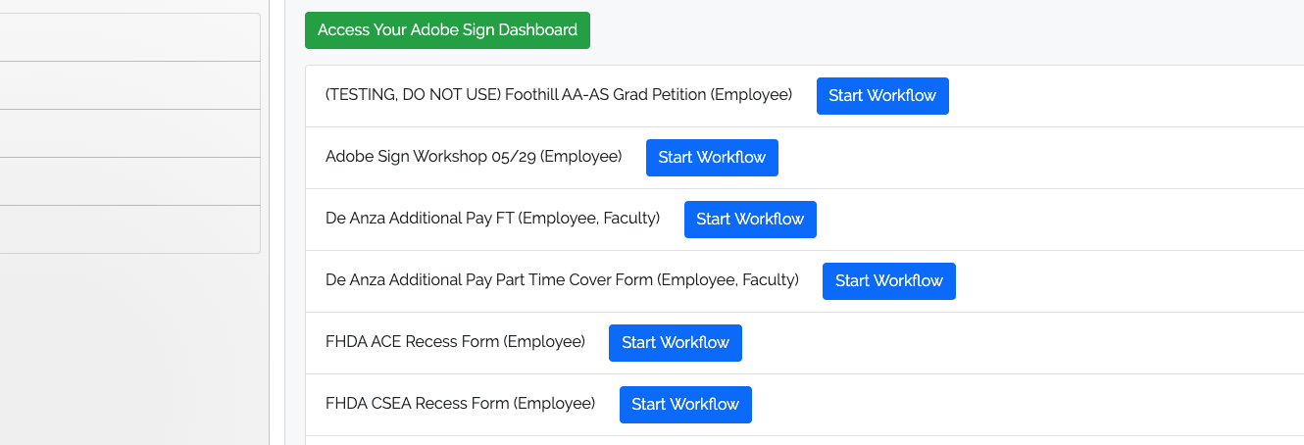
So what are Workflows you ask???
They are Pre-defined ways for us to obtain the necessary signatures on a specific form.
In fact the ETS folks were kind enough to build a Workflow Especially For This Workshop!!

Slide 8
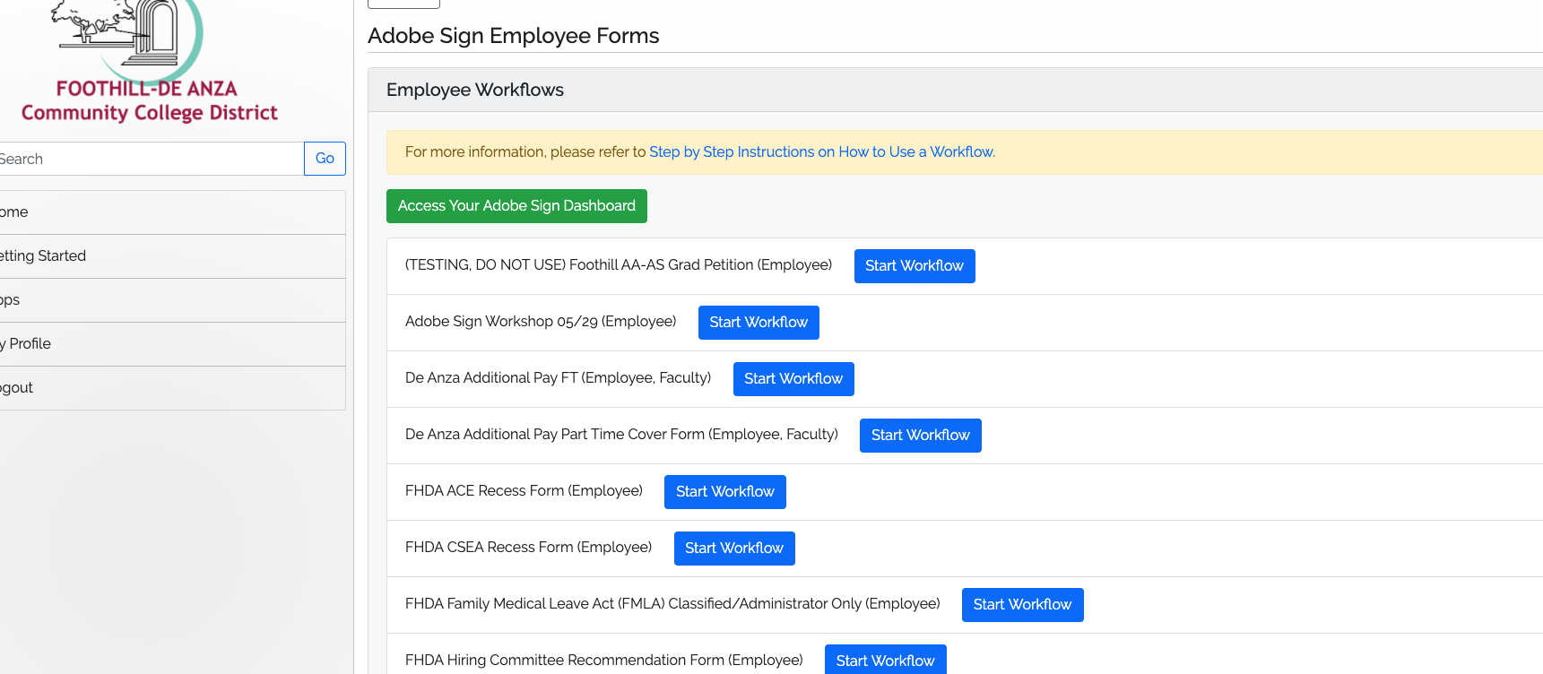
We’re Going to Practice ;-)
Click on the Blue Button that says Start Workflow for the Adobe Sign Workshop 05/29

Slide 9
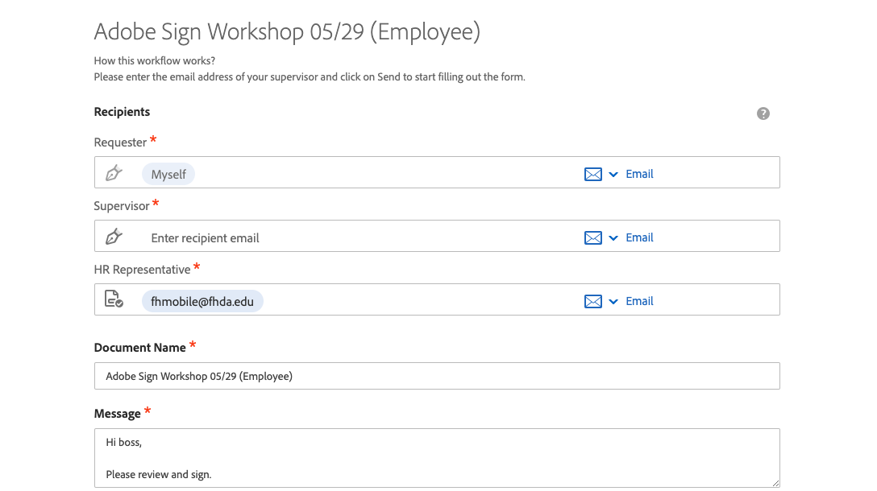
Hopefully, you got this:

Slide 10
Workflows have a form already attached. You’re going to start “the flow”
We’re going to add a “Supervisor” – a fake one for this – Use: damobile@fhda.edu

Slide 11
Because the first person was “Myself,” the form will pop up on your screen.

Slide 12
Go Ahead And Fill In Some Random Stuff!

Slide 13
Keep Going Through Filling In Your Signature and Extension – Then “Click to Sign”
When Done “Click to Sign”

Slide 14
Now You Should Get This:
Success!!! These days we’ll take any little “Win” we can…

Slide 15
Your “Supervisor” will receive an email like this(in this case the kind folks at ETS who are monitoring damobile@fhda.edu for this session):

Slide 16
Want to keep an eye on things? Let’s “Access Your Adobe Sign Dashboard”

Slide 17
You can see on my screen that I have 5 documents “In progress” and 2 waiting for me to sign

Slide 18
Click on In Progress to see the form you sent

Slide 19
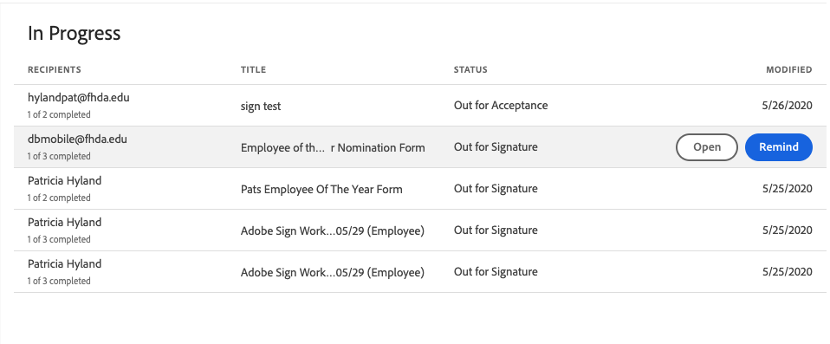
“But I want to know if it’s signed” (I hear you say)
Hover over the one you want to check on and you have 2 options: Open and Remind

Slide 20
In the case of a form that needs multiple signatures, if you click on Open you can see which ones are still needed

Slide 21
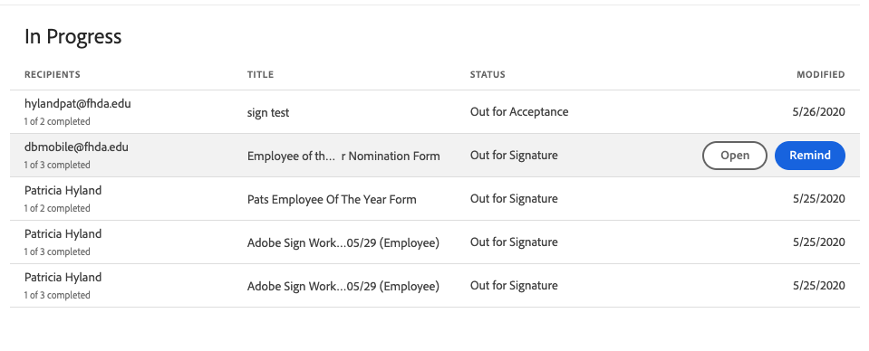
If you get impatient you can click Remind
Use it judiciously….

Slide 22
Now we’ll explore some other things you can do with your Dashboard

Slide 23
Say you want to nominate yourself for Employee Of The Year and the form needs your supervisor’s signature – You’ll need to do a few things first

Slide 24
Download the “Employee of The Year Nomination Form” from Zoom Chat

Slide 25
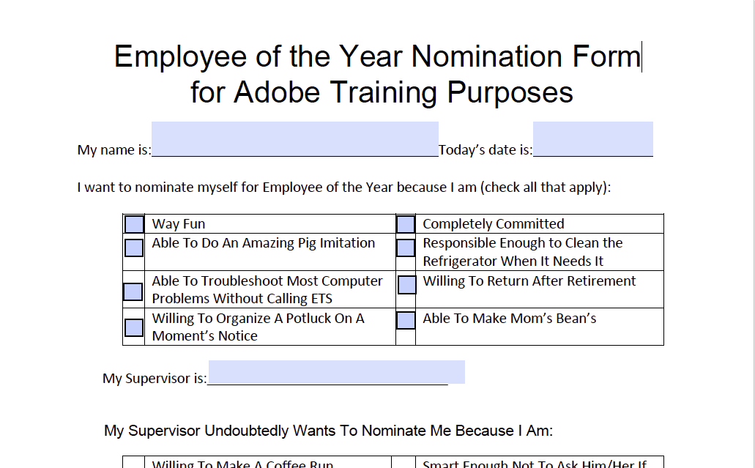
#1 - Fill out and Save the form on your computer – DON’T Sign It!

Slide 26
Now we can Request signatures

Slide 27
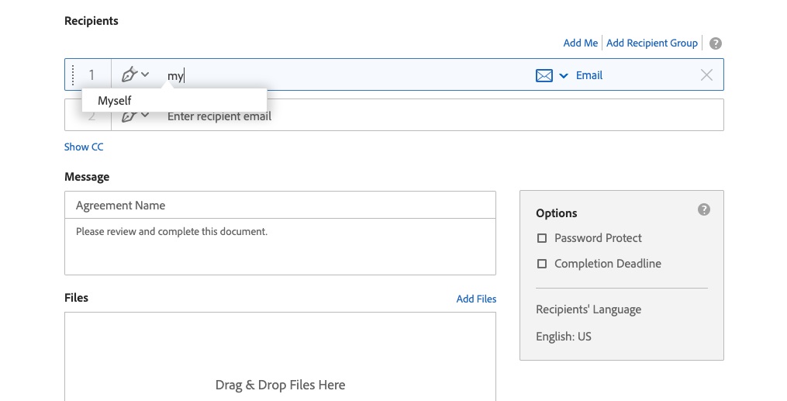
Since you need to sign the form, type Myself in line #1

Slide 28
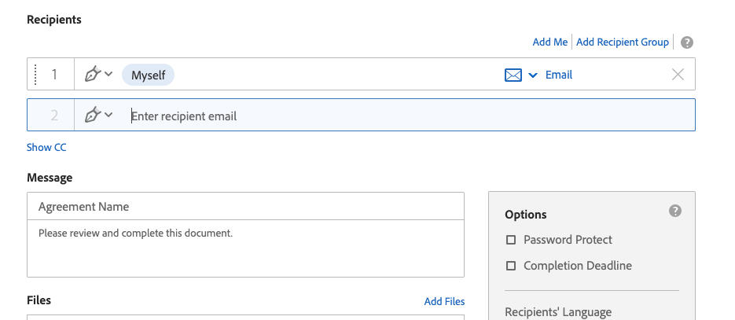
…And we need our “supervisor” damobile@fhda.edu Type that in here:

Slide 29
We also want to send it to its final destination, but that person doesn’t need to sign it. Pull down the arrow by the pen tip and change it to “Acceptor”
Let’s use my email for this: hylandpat@fhda.edu

Slide 30
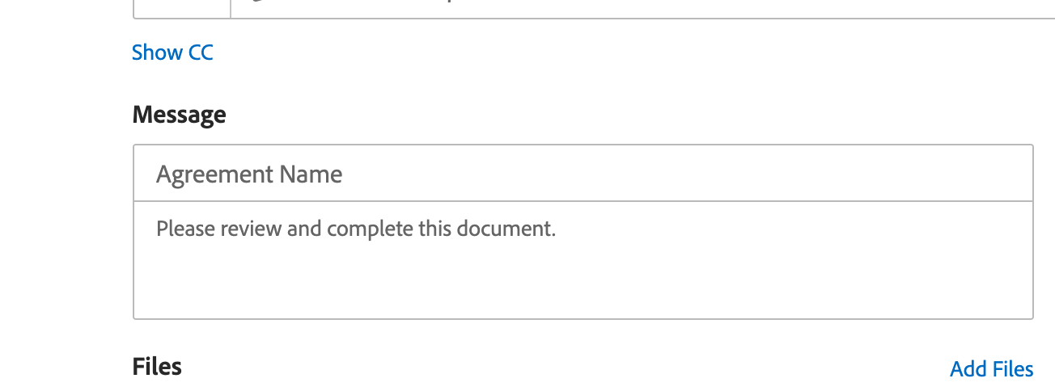
If you change the Agreement Name to the name of the form you need signed, the message automatically updates

Slide 31
Now either click Add Files OR drag and drop the form from your computer to this box

Slide 32
Now click that tiny little box called Preview & Add Signature Fields

Slide 33
When you click it, Send changes to Next

Slide 34
You’ll see a message like this

Slide 35
…Then the form you uploaded should pop up

Slide 36
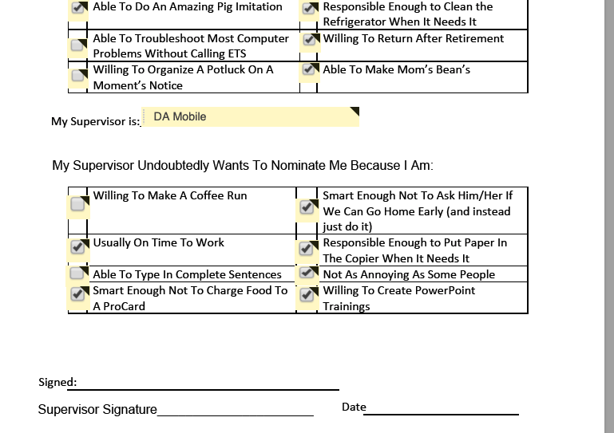
Mostly filled out – except those pesky signatures
But the form doesn’t really have interactive sign spots so we’re going to add them!

Slide 37
On the Right side of the screen click on Signature Fields

Slide 38
Grab that top one called Signature and drag it over the line where you want to sign

Slide 39
To make sure the “right people” sign in the “right order” click on the Pink corner
Here you get to “Assign” it to yourself (Sender)

Slide 40
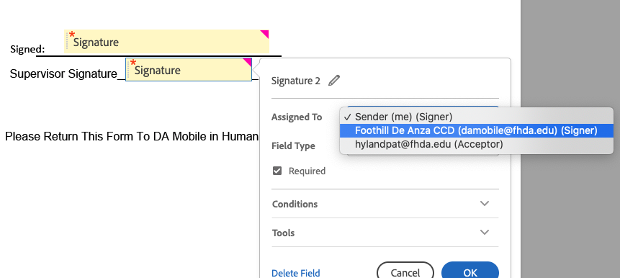
Now drag and drop another one we’ll assign to your supervisor. Use the Pink corner again to make sure it is going to damobile@fhda.edu.

Slide 41
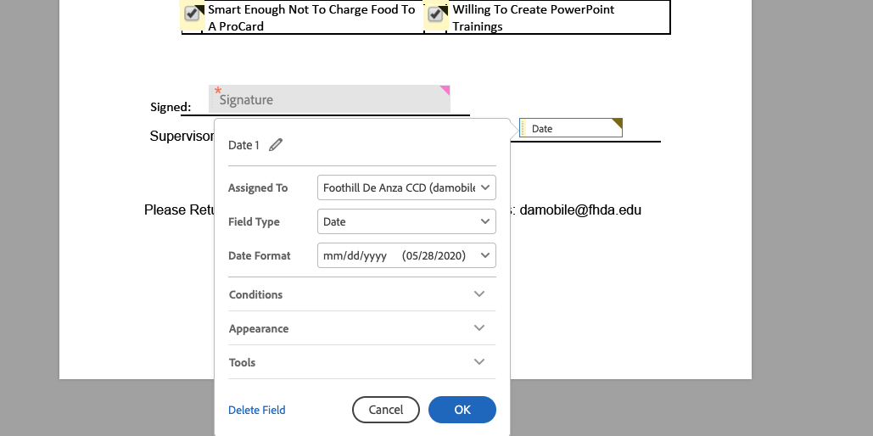
We’ll also add a date field that only your supervisor can complete

Slide 42
Now you can sign it and send it on its merry way!!!

Slide 43
Depending on your login info, your name will pop up in some fashion. Verify by typing it below then click Apply

Slide 44
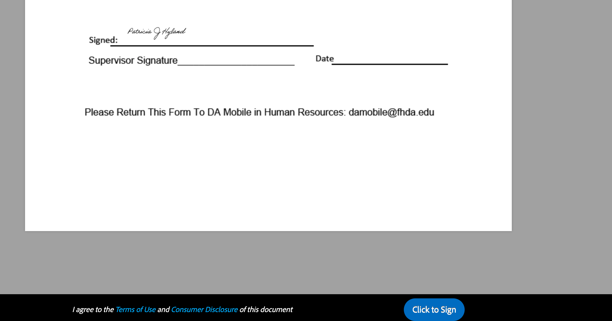
You’ll get one last message Click to Sign

Slide 45
Hit Click to Sign and it’s on it’s way!

Slide 46
And when your “supervisor” signs it you’ll get this!!!

Slide 47
Watch them do in 3 minutes what took me an hour ☹

Slide 48
Cool info on choosing order of signatures:
https://helpx.adobe.com/sign/how-to/adobe-use-hybrid-routing.html?playlist=/content/help/en/ccx/v1/collection/product/sign/segment/designer/explevel/beginner/applaunch/orientation/collection.ccx.js

Slide 49
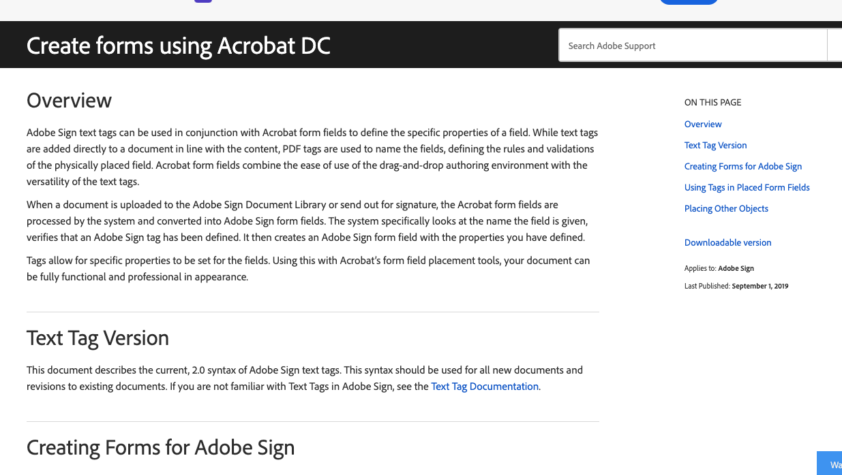
Also, a Very Good resource:
https://helpx.adobe.com/sign/using/create-forms-with-acrobat.html

Slide 50
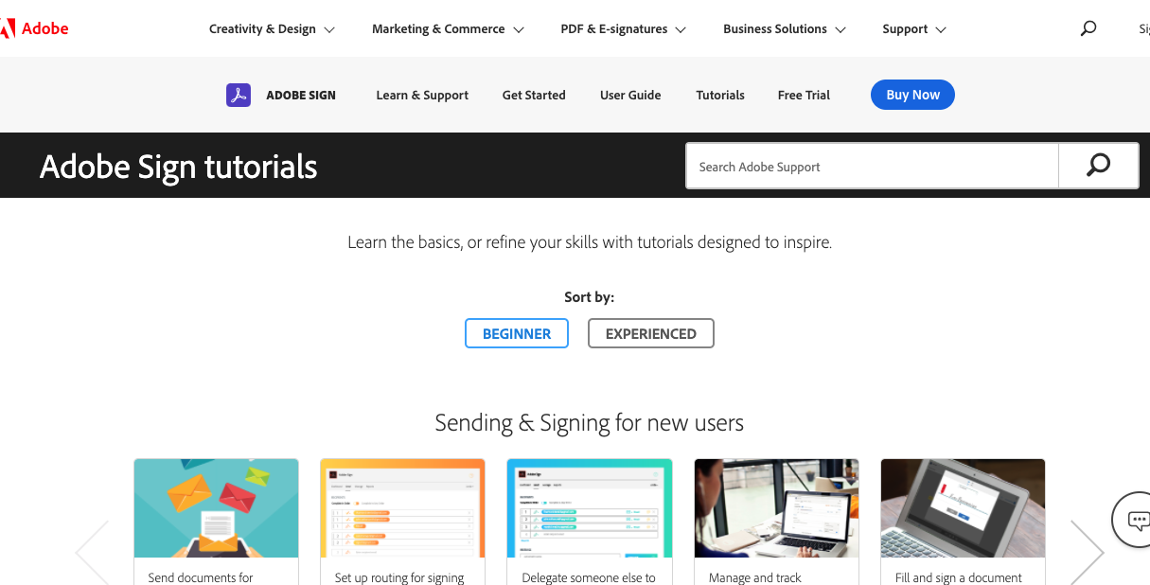
Wasn’t that fun?????
Resources: https://helpx.adobe.com/sign/tutorials.html

Slide 51
Special thanks to: Claire Chang Monica Garcia Jyoti Gavali Mahmood Hasan Linda Koyama Paula Norsell

Slide 52
Now get out there and request signatures!

